Slide 1
Clinical Research Billing Process in Epic
Research Coordinator Training
Kristin Parks, Director Clinical Research Finance and Administration

Slide 2
Research Studies in Epic
The studies REQUIRED to be in Epic are those that have research billing requirements.
The below 2 criteria describes “research billing requirements”
If any clinical charges drop in billing system related to the study that should be paid for by the study account
And/or
2. Qualifying Trial in which UTP will bill for routine/SOC services
When routine care is noted as part of the research protocol, NCT # & codes and modifiers must be added to claims per billing requirements.

Slide 3
Research Studies in Epic
Research Team responsibilities
Keep track of all studies loaded into Epic
For all studies loaded into Epic
    Link /associate patients
    Link/associate Research visits
    Review research charges
SPA Responsibilities:
Load all studies that will require research billing handling in Epic
Notify research team that study will be in Epic (sent when CA build is complete)
  Send email notification
  Notate study as “CA Approved Epic “ in START

Slide 4
Research Studies in Epic
A coverage analysis lists out all services and procedures performed at each visit and notates each items with one of the below designations:
Research---Bill to study
SOC --Routine care to be billed to patients account
NB --Not billable and will not generate a charge in billing system (i.e. Informed consent or questionnaires)
Notes:
What exactly are we talking about?
Invoicing Department for charges related to research
To be paid from funds in individual project accounts
In turn, the study team invoices sponsor to get paid for these clinical procedures
Invoicing Insurance for charge related to research that are routine costs
Qualifying Trials must have research codes and modifiers.

Slide 5
Research Studies in Epic
SPA’s CRF team ensures a Coverage analysis is built out for all applicable studies.
  As part of the CA workflow, the CRFA team determines if the study should be loaded into Epic.
  The Study Coverage analysis record in START is where the notes regarding Epic load determination are located.
Please download a copy of the CAIB tool Guidance document for more detailed understanding of the process flow
Located on SPA website under forms/tools under the CRF team section
Notes:
What exactly are we talking about?
Invoicing Department for charges related to research
To be paid from funds in individual project accounts
In turn, the study team invoices sponsor to get paid for these clinical procedures
Invoicing Insurance for charge related to research that are routine costs
Qualifying Trials must have research codes and modifiers.

Slide 6
Research Studies in Epic
Department is responsible for keeping track of which studies are in Epic/require research management in Epic.
New study coordinators can be added to the study record in Epic by the research team if there are changes in staffing.
Study team can also pull reports from START to list out all of studies in Department/Division with status “CA Approved –Epic”
Notes:
What exactly are we talking about?
Invoicing Department for charges related to research
To be paid from funds in individual project accounts
In turn, the study team invoices sponsor to get paid for these clinical procedures
Invoicing Insurance for charge related to research that are routine costs
Qualifying Trials must have research codes and modifiers.

Slide 7
Clinical Research Billing Process in Epic
Professional Fees
  Many SC’s are unaware of the fact that services performed at MHH, LBJ, or HH clinics may generate professional fees in UTP Epic.
  It is possible for a study conducted entirely at one of the above locations yet professional fees will still be entered into UTP’s Epic.
Notes:
Before we get started lets clarify which studies will be entered into Epic requiring study coordinator input for research billing
FDA “Qualifying” trial therefore the NCT number with research codes and modifiers need to be added to the claims

Slide 8
Clinical Research Billing Process in Epic
Study Teams are responsible for three steps in Epic for Research Billing Management:
1. Note patient as research participant
  Link/associate patient to research study in Epic
2. Flag Visit/Encounter as a “research visit”
  Even if SC does not schedule he/she can notate appointment as “research Visit” using reports in Epic
3. Review charges generated for research billing compliance
  Follow the coverage analysis to ensure charges are correctly notated

Slide 9
Clinical Research Billing in Epic
STEP 1 : FLAGGING Patients as Research Participant
  Link/associate patient to study
  Notate patient as “enrolled”
  Video showing how to link patients to study on next slide
Notes:
Interested [1020]
Waiting for consent [1050]
Consented - in screening [1055]
Enrolled [1060]
Completed [1070]
Withdrawn [1090]

Slide 10
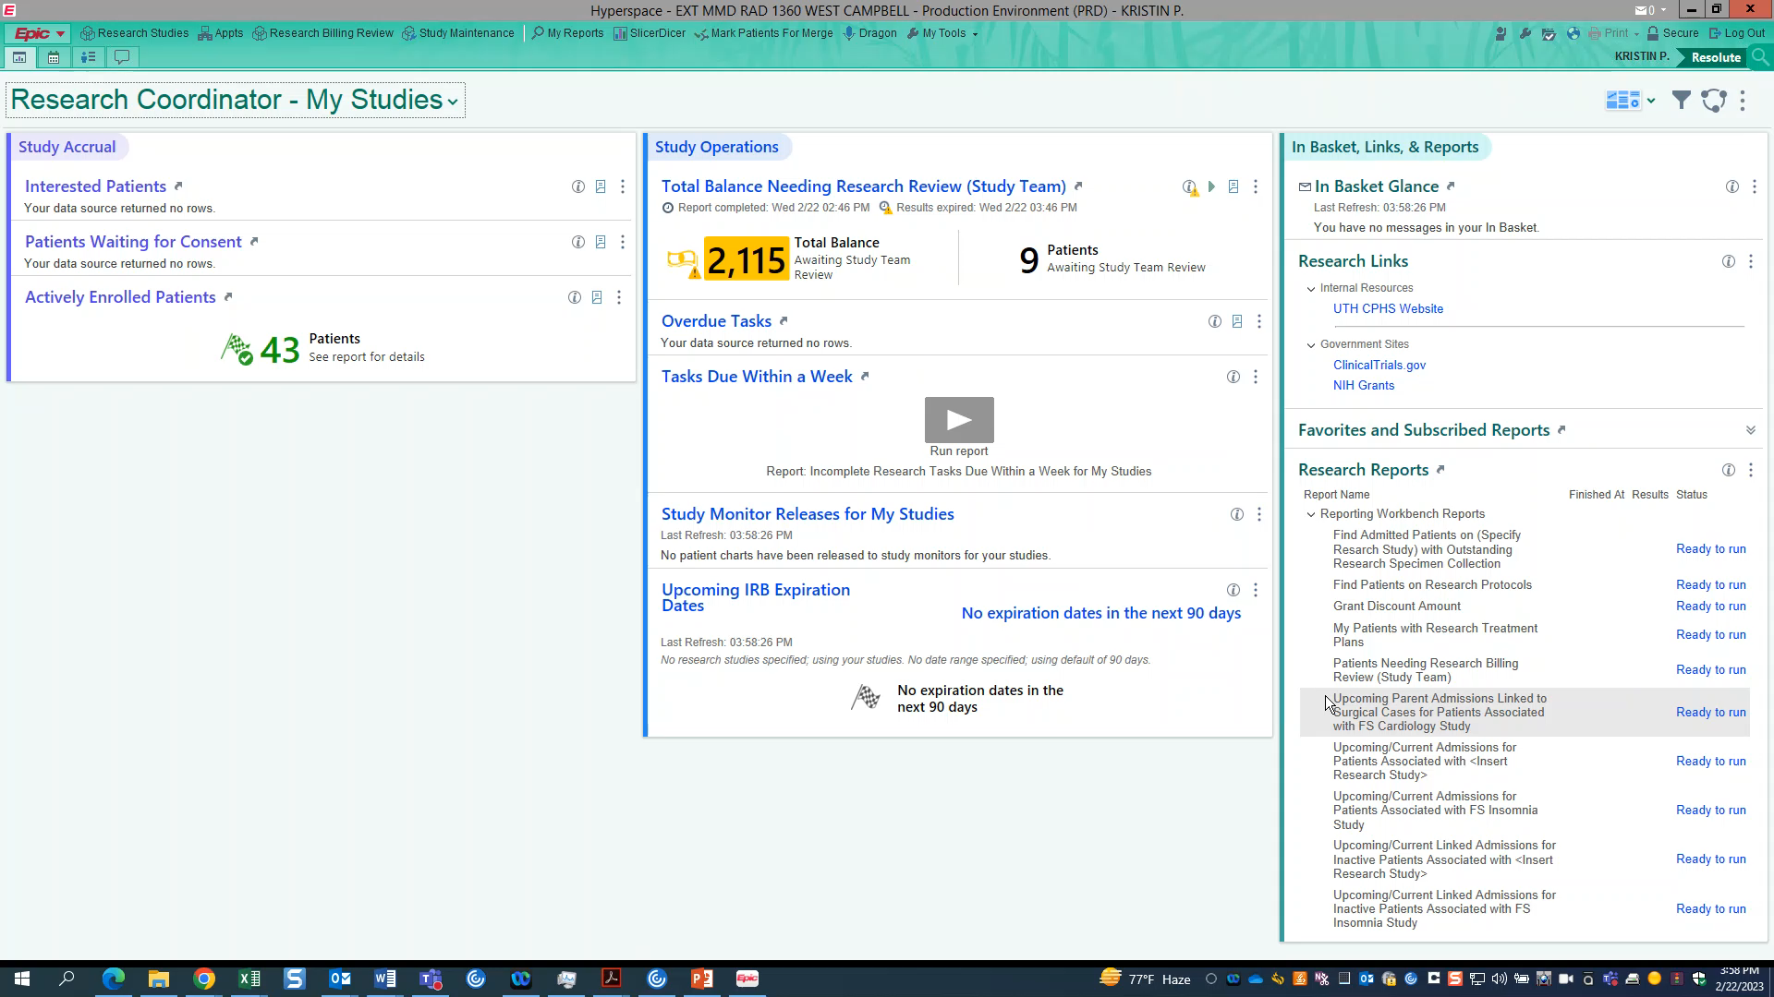
Clinical Research Billing in Epic

Slide 11
Clinical Research Billing in Epic
Step 2 : FLAGGING research visit/encounter as “research”
  Create “upcoming appointment” report for each of your studies loaded into Epic
  Run report on regular basis – If you see a research visit is not “linked “ to the study, you can do this from the report.
    Linking patient to study is only the first step, the visit encounter must also be linked.
      If linking the visit encounter to the study is missed, the patient/patient’s insurance will be billed.
        This will result in unhappy patients who may decide to drop from the study
        This is a billing violation that could result in fines for the university and loss of federal funding.

Slide 12
Clinical Research Billing in Epic
Step 2 : FLAGGING research visit/encounter as “research” (continued)
  The next slide is a short video showing how to create this report in Epic.
    The report will allow you to view the upcoming visits scheduled for all patients linked to your study(ies).
    You will be able to easily notate which visits are research visits.
      You will need to cut and paste:
        Upcoming/Current Admissions for Patients Associated with <Insert Research Study>
          Cut and paste the above into the “Reports Library” in Epic
          Follow the instructions on the video on the next slide

Slide 13
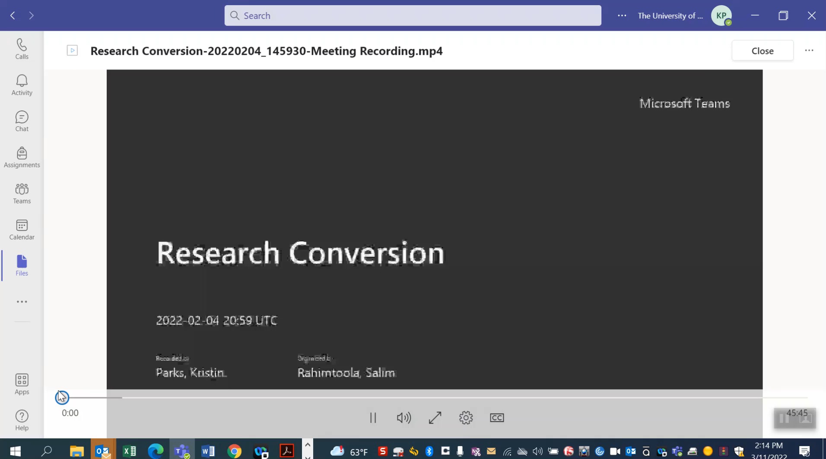
Clinical Research Billing in Epic
Step 2 continued

Slide 14
Clinical Research Billing in Epic
Step 3 : Review Research Charges
  Refer to Coverage analysis to ensure you are notating correctly
This report is on Epic Dashboard

Slide 15
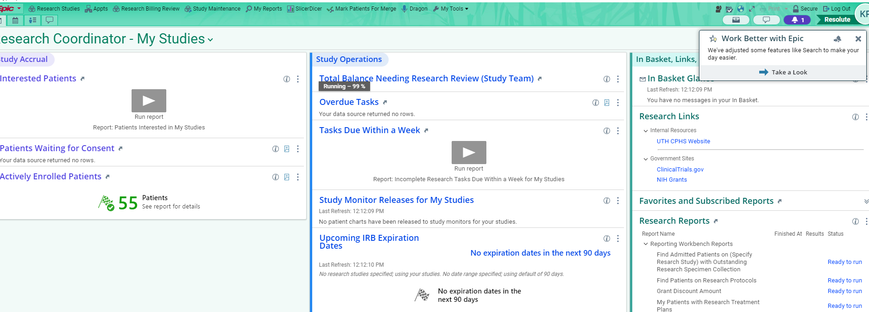
Clinical Research Billing in Epic
Log into Epic
Click on “Total Balance Needing Research Review (Study Team)”

Slide 16
Clinical Research Billing in Epic
Following the Coverage analysis, ensure charges for the research visit are in the correct “bucket”
There are three “ buckets”
  Study Related- Bill to Study
  Study Related – Bill to Patient/Patient’s insurance
  Non Study Related
  The next slide is a video showing you how to move the charges into the correct “bucket”

Slide 17

Clinical Research Billing in Epic

Slide 18
Clinical Research Billing in Epic
Summary of Video
  Refer to the Coverage analysis document to clarify which “bucket” each charge belongs to
  Move charges to the correct bucket
  Click on “Mark as Reviewed”
  Click “submit”

Slide 19

Clinical Research Billing in Epic
The next slide is a quiz to test your knowledge in Clinical Research Billing in Epic.
Be sure to use the scroll bar on the right hand side of the quiz to access/answer all of the questions.

Slide 20
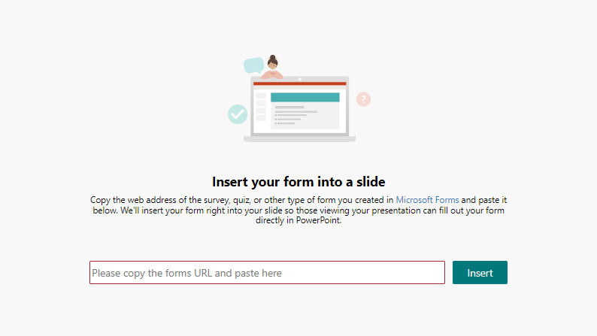
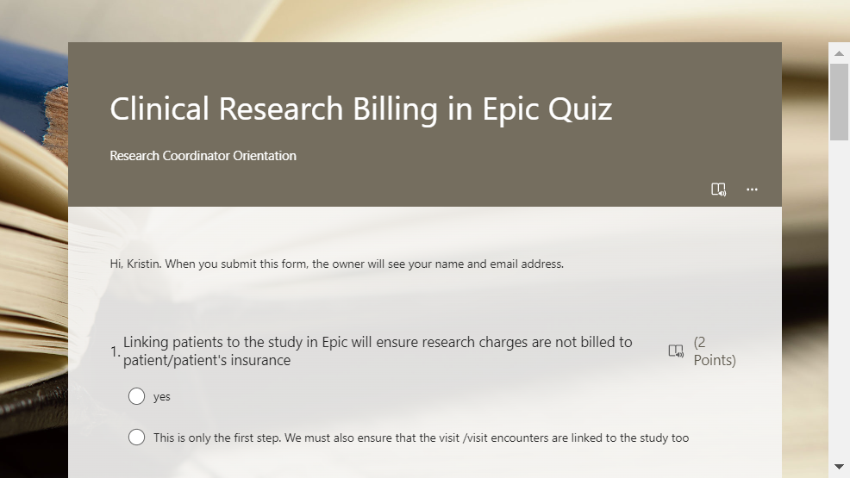
Clinical Research Billing in Epic-QUIZ

Slide 21
THANK YOU
You have completed the Epic Research Billing Orientation Presentation

